Slide 1



OPAL Tools
Free Tools for Oracle Software Development
Dietmar Aust Opal-Consulting, Cologne
www.opal-consulting.de

Slide 2
Agenda
WHY? Background / Context
The Solution
Download / GitHub
Demo

Slide 3
WHY? Background / Context
Notes:
Drag your picture and Send to Back

Slide 4
WHY? Background / Context
20+ years of custom development for Oracle: PL/SQL, SQL, Forms, Reports, APEX, have seen very different approaches
Typical project has multiple environments, e.g.:
Development
Test
Production
… or even more
Manage sources differently
SQL and PL/SQL objects (1:1 in database)
„Manual“ scripts (e.g. alter table add column or generate synonyms, grants and views on the fly)
Other sources (Java, shell scripts, node.js, …) possible but out of scope

Slide 5
WHY? Background / Context
Different people use different workflows
The database is the master – with or w/o version control
The file system is the master – typically with version control
A mix of the two (working alone most of the time and/or forgot to use the file). Easy synchronization would be nice.
Different projects – different tools
Cannot rely 100% on a specific tool
Most tools don‘t work well on the command line (either calling and/or customizing them)

Slide 6
WHY? Background / Context
Issues with current solutions
When exporting sources from the database, there are always some issues with the exporter tools.
Errors when running dbms_metadata
Choosing the objects you need by object name (include, exclude) or object type (include, exclude)
Generating files in the right locations, e.g. package specifications and package bodies should be in the same directory

Slide 7
WHY? Background / Context
Issues with current solutions
Don‘t want to install additional objects in the target database (e.g. the production system)
Scripting must be possible, all manual procedures can possibly change the outcome

Slide 8
The Solution
Notes:
Drag your picture and Send to Back

Slide 9
The Solution
The software:
Written in Java + (generated) batch scripts
Works on Windows, MacOS and Linux
Exporter leverages DBMS_METADATA and SQLcl
Installer leverages SQLcl
Java application opal-export
Java application opal-install
DBMS_METADATA
SQLcl
SQLcl

Slide 10

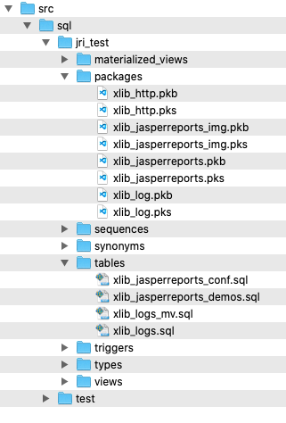
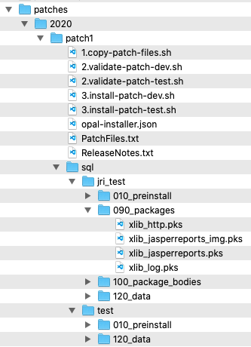
The Solution
Source Files
Patches
install
Test
Export with
DBMS_METADATA
Copy files
Development
install
Export:
Database Objects
APEX applications
ORDS modules
Custom spool scripts
Patch / Deployment:
SQL scripts
Executed with SQLcl
Production
Patch Installation can be automatically registered

Slide 11
The Solution
Goals / Benefits
Highly customizable (no specific approach is hardcoded, everything should be able to adapt to your needs)
Easy to install and configure
Consistency of the approach, plays nicely with all tools (SQLDev,Toad,…)
Support for different workflows
Work from the filesystem as master
Work from the database as master
Mix both
Record the execution of each patch in the database
A real timesaver
Easy to use for beginners, highly adaptable for experts

Slide 12
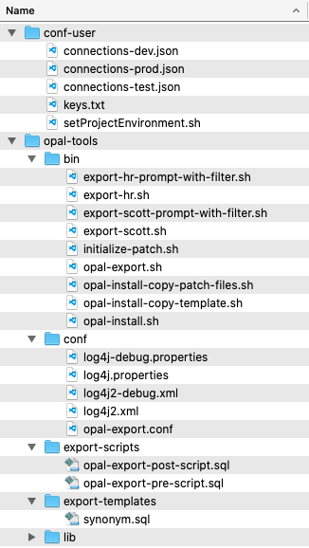
The Solution
E.g. run setup for schemas HR and SCOTT and environments dev,test,prod
Folder „conf-user“
Typically outside of GIT / SVN repository

Slide 13
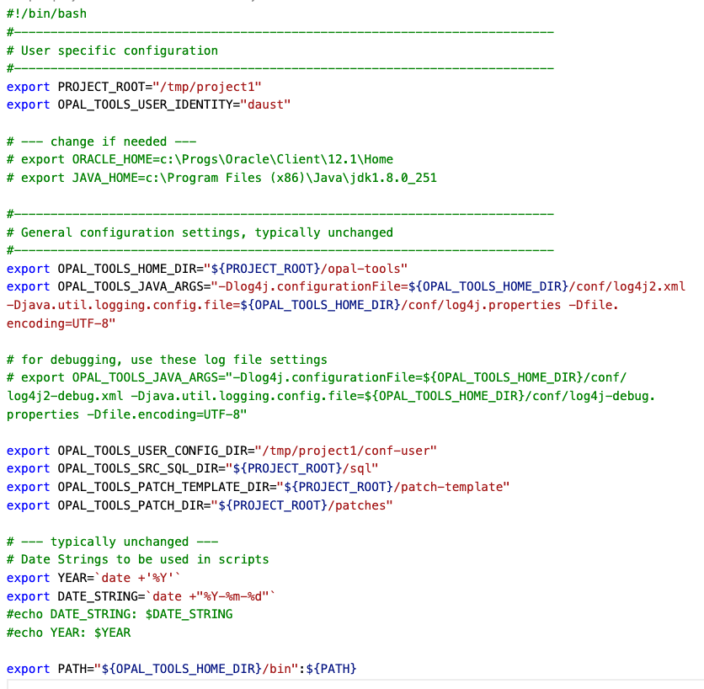
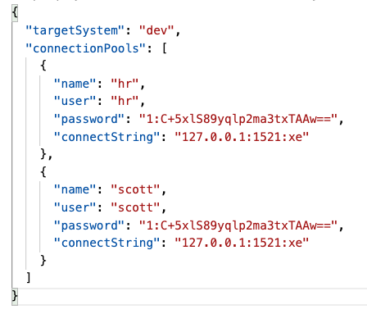
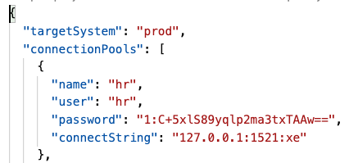
The Solution
setProjectEnvironment.sh / cmd
connections-dev.json
connections-prod.json

Slide 14
The Solution
Folder „opal-tools/bin“
Contains scripts to call the Java programs
Contains generated scripts for each database schema

Slide 15
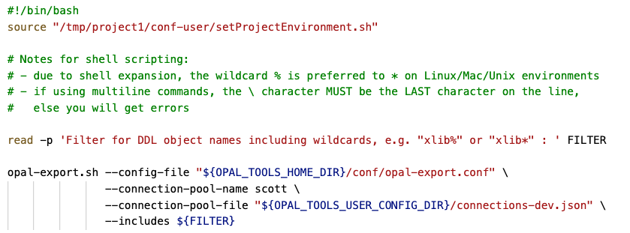
The Solution - EXPORT
opal-export.sh
calls setProjectEnvironment.sh first
simple wrapper for the Java application
export-scott-prompt-with-filter.sh
calls setProjectEnvironment.sh first
Prompts for like-filter of db objects
Uses the connection pool for the development environment

Slide 16
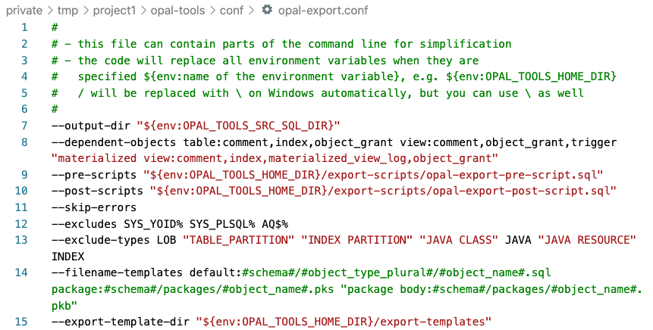
The Solution - EXPORT
Folder „opal-tools/conf“
Config files for the logging
Config file for global settings

Slide 17
The Solution - EXPORT
Folder „opal-tools/export-scripts“
Run before or after exporting the DDL for the selected objects

Slide 18
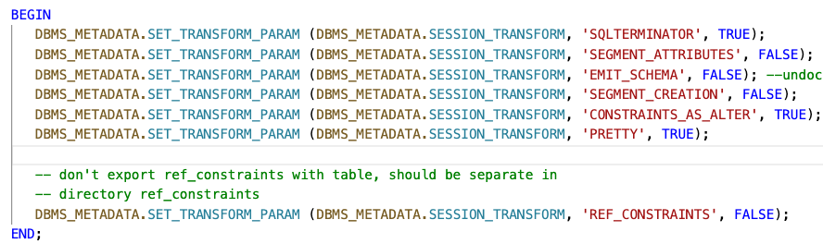
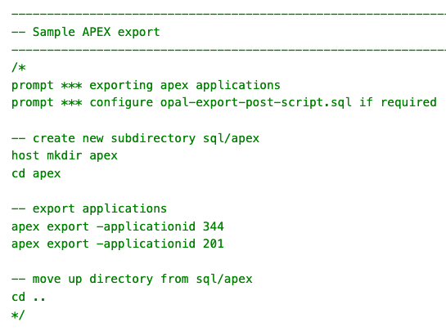
The Solution - EXPORT
opal-export-pre-script.sql
opal-export-post-script.sql

Slide 19
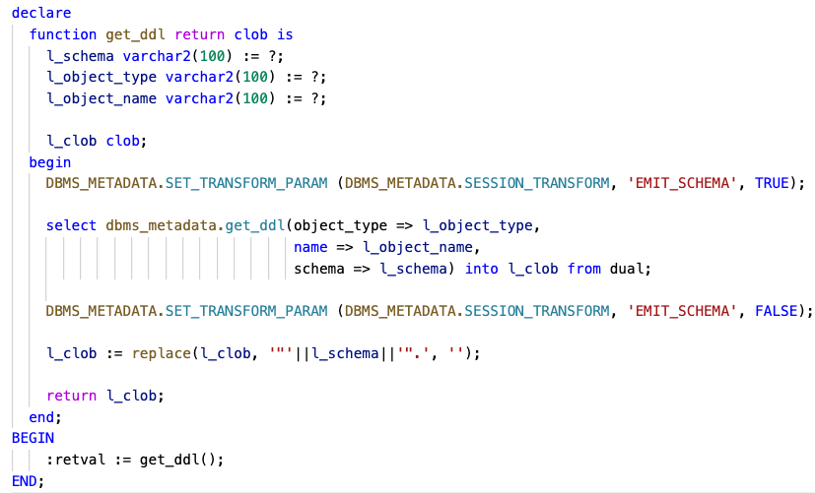
The Solution - EXPORT
Folder „opal-tools/export-templates“
Override the general call to dbms_metadata.get_ddl()

Slide 20
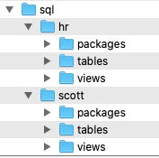

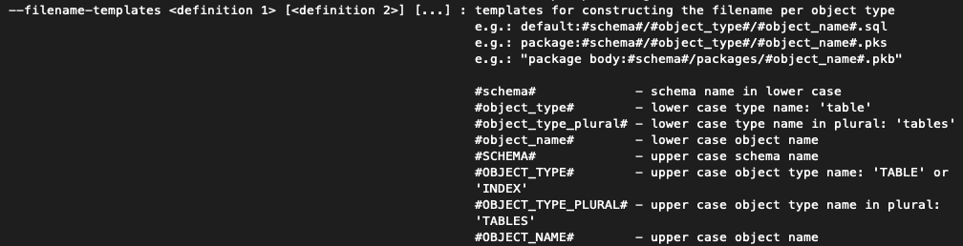
The Solution - EXPORT
Folder „sql“
Export of database object into files

Slide 21
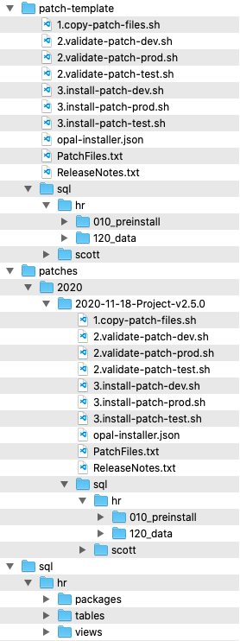
The Solution - INSTALLER
Folder „patch-template“
Will be used as a template for a new patch (copy directory and subdirectories)
Folder „patches“
<year>/<year-month-day>-<patch name> is generated through the batch script initialize-patch.sh
Folder „sql“
sql source files

Slide 22
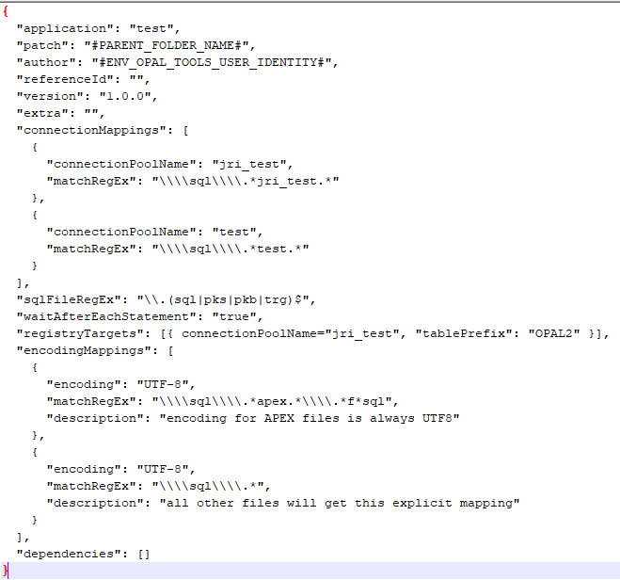
The Solution - INSTALLER
Config file for the patch: opal-installer.json

Slide 23

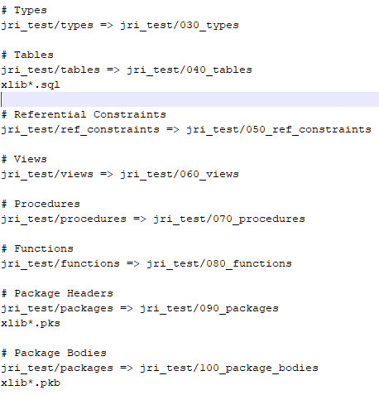
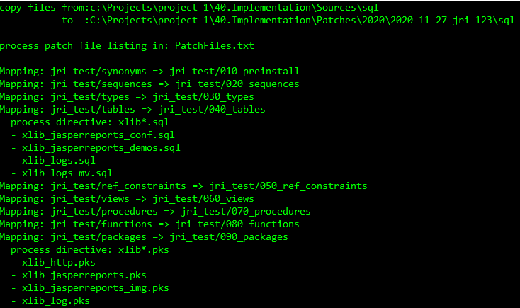
The Solution - INSTALLER
1.copy-patch-files.sh
Copies files from the source tree to a target tree

Slide 24
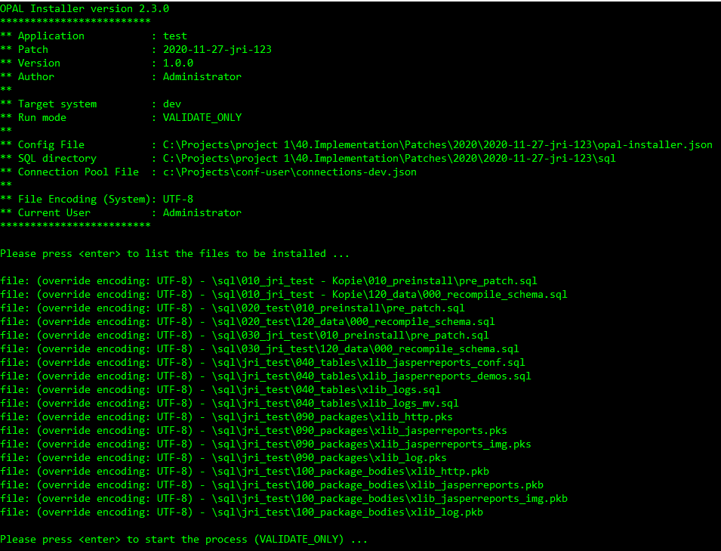
The Solution - INSTALLER
2.validate-<environment>.sh
Validates connection pool and shows files in the order they will be installed

Slide 25
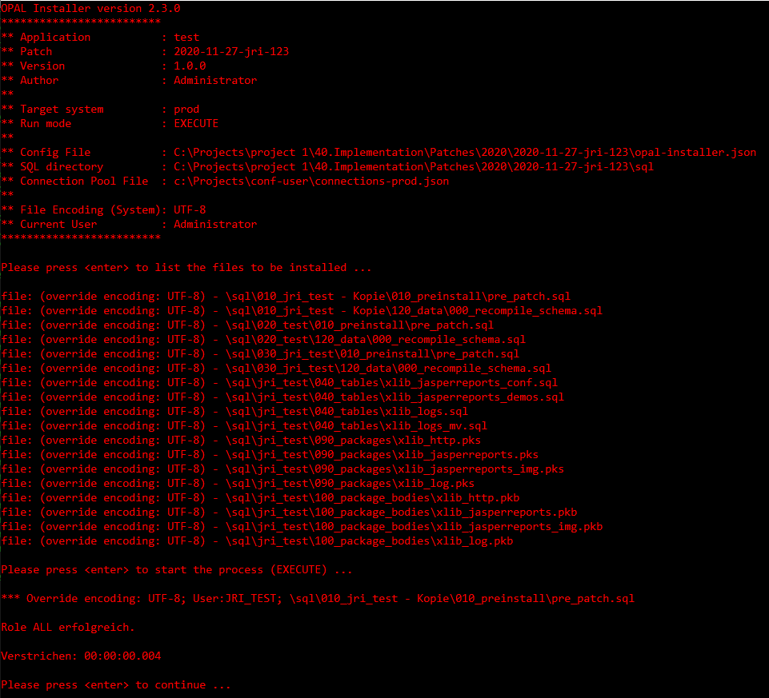
The Solution - INSTALLER
3.install-<environment>.sh

Slide 26

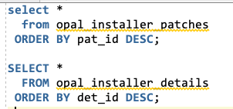
The Solution - INSTALLER
ReleaseNotes.txt

Slide 27
Download / GitHub
Notes:
Drag your picture and Send to Back

Slide 28
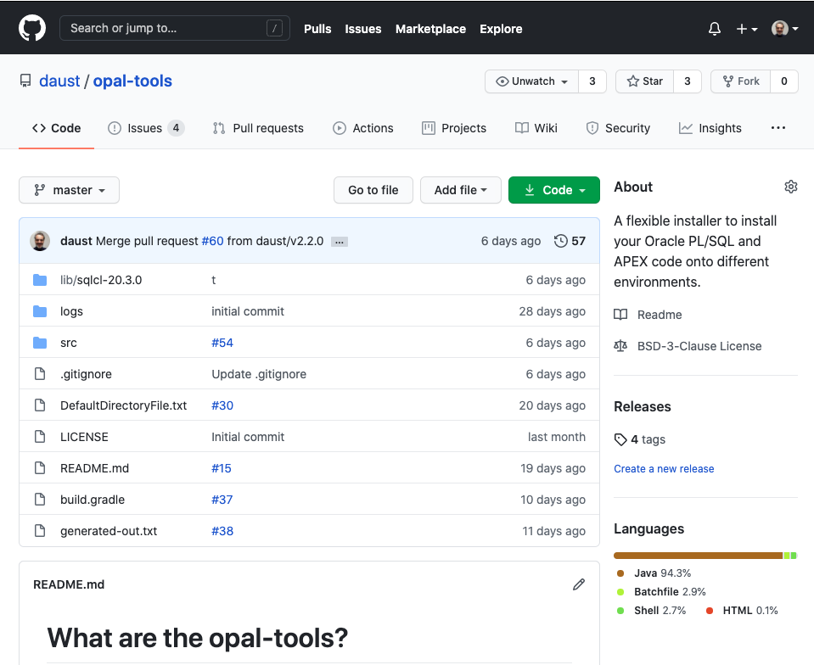
https://github.com/daust/opal-tools

Slide 29
Demo
Notes:
Drag your picture and Send to Back

Slide 30
Questions?
Opal Consulting
Email / Website
Zum Tilmeshof 11
50859 Köln
Germany
dietmar.aust@opal-consulting.de
www.opal-consulting.de

